Slide 1
Planning Problem and Maximum Satisfiability
KNOWLEDGE REPRESENTATION AND LEARNING
Professor Luciano Serafini
Academic Year 2022-2023
Presented by: Chelsie Romain (Matricola: 2072067)
Presented on: September 15th, 2023

Slide 2
Table of Contents
The Planning Problem
Statement of the Problem
Modelling the Problem
Implementation
Shortest Path
Demonstration of Solving the Planning Problem
The Assigned PROBLEM
The Plan Graph
DIMACS ENCODING
Optimal Plan

Slide 3
The Planning Problem

Slide 4
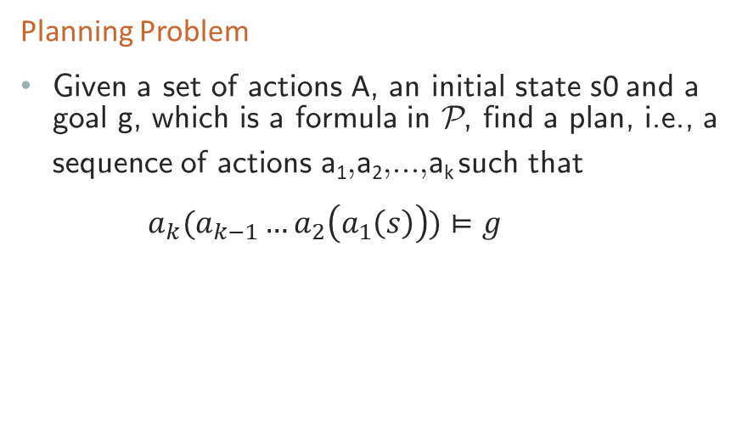
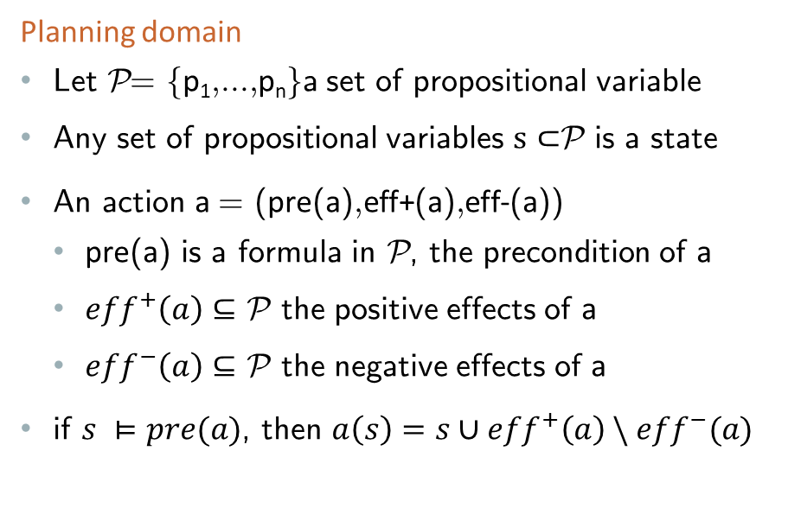
Statement of the Problem
Planning domain
Let P = fp₁; : : : ; p_{n}g a set of propositional variable
Any set of propositional variables $s⊂$P is a state
An action a = (pre(a); eff+(a); eff-(a))
pre(a) is a formula in P, the precondition of a
${eff}^{+}\left(a\right)⊆$ P the positive effects of a
${eff}^{−}\left(a\right)⊆$ P the negative effects of a
if $s ⊨pre(a)$, then $a\left(s\right)=s∪{eff}^{+}\left(a\right) \backslash {eff}^{−}(a)$
Planning Problem
Given a set of actions A, an initial state s0 and a goal g, which is a formula in P, find a plan, i.e., a sequence of actions a₁; a₂; : : : ; a_{k} such that
$a_{k}(a_{k−1}…a_{2}\left(a_{1}\left(s\right)\right))⊨g$

Slide 5
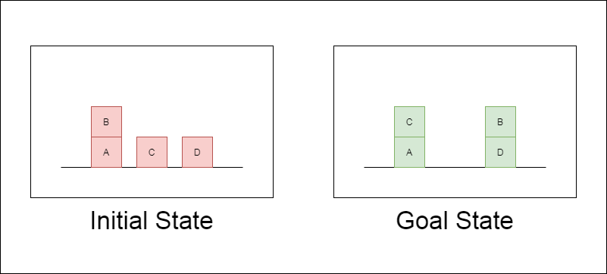
Statement of the Problem
Required:
Codify the problem of finding a plan of length less then or equal to k for reaching the goal g from an initial state s0 as a SAT problem.
Create a planning domain to solve the planning problem shown in the following picture:
RULES
You can move blocks only if they don't have other blocks on top,
You can move them either on top of other blocks or on the table.
Find the smallest k for which a plan exists.

Slide 6
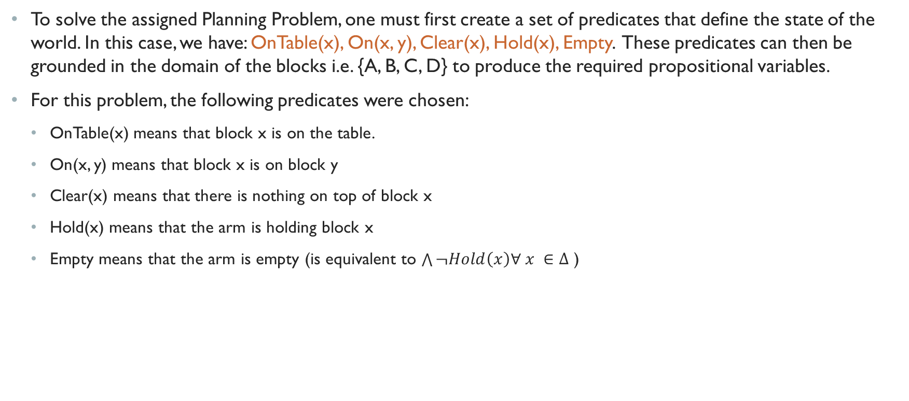
Modelling the Problem
To solve the assigned Planning Problem, one must first create a set of predicates that define the state of the world. In this case, we have: OnTable(x), On(x, y), Clear(x), Hold(x), Empty. These predicates can then be grounded in the domain of the blocks i.e. {A, B, C, D} to produce the required propositional variables.
For this problem, the following predicates were chosen:
OnTable(x) means that block x is on the table.
On(x, y) means that block x is on block y
Clear(x) means that there is nothing on top of block x
Hold(x) means that the arm is holding block x
Empty means that the arm is empty (is equivalent to $\bigwedge{¬Hold\left(x\right)∀ x ∈Δ}$ )

Slide 7
Modelling the Problem
Next, to find a plan, we create a planning graph. The planning graph is a graph whose nodes represent states and whose edges represent actions.
A state is a collection of propositional variables which are True. Each propositional variable is derived from the grounding of a corresponding predicate in the domain of the blocks.
An action allows for a transition between states. They are defined by their preconditions, add, and delete effects as per the previous section.
For this problem the following actions were defined:
Actions | Preconditions | Add-effects | Delete-effects
MoveFrom(x, y) | Empty, On(x, y), Clear(x) | Hold(x), Clear(y) | Empty, On(x, y), Clear(x)
MoveTo(x, y) | Hold(x), Clear(y) | On(x, y), Clear(x), Empty | Hold(x), Clear(y)
FromTable(x) | OnTable(x), Clear(x), Empty | Hold(x) | OnTable(x), Clear(x), Empty
ToTable(x) | Hold(x) | OnTable(x), Clear(x), Empty | Hold(x)

Slide 8
Modelling the Problem
Once the planning graph has been built, a plan can be extracted by finding a path from the initial state to the goal state via a series of actions. The optimal path is then given by the shortest path between the two required states.
The task of finding the optimal path can be solved using maximum satisfiability. The length of the optimal path gives the smallest k (number of actions) for which a plan exists.
Modelling the optimal path can be done by using a set of weighted propositional formulas, and then solved for an assignment of literals (nodes) that satisfies all the formulas. There are many SATSolvers available and for this project RC2 was used because it is efficient and user-friendly implementation in python.

Slide 9
Implementation
One of the more difficult tasks for this project was modelling using propositional logic. The benefits of predicate logic is its expressivity. Using the sympy library allows for the use of symbols for Boolean propositional logic.
When attempting to use these symbols for predicate logic, we lose the expressivity because when the predicate becomes symbolic it can no longer be parsed as a predicate and we lose the information about properties and relations between objects.
One way to combat this would be to define a new class in python for a predicate data type. However, a much simpler solution is to simply use strings. Parsing the string allows us to determine which predicates are being applied to which objects in the grounding of the domain.
The collection of the set of strings representing the grounded predicates, can then be treated as propositional variables without loss of expressivity.
Important prerequisites:
The python code does not perform inference. It assumes that the initial and goal states are described in their entirety and contains no omissions. For example, for a human it may be enough to state that there are 4 blocks A, B, C, and D and that S₀ = {OnTable(A), OnTable(C), OnTable(D), On(B, A)} from this we can infer Blocks B, C, and D are Clear and the arm is Empty. However, the program requires that the property of being Clear and Empty is explicitly stated with the appropriate predicates for each block.

Slide 10
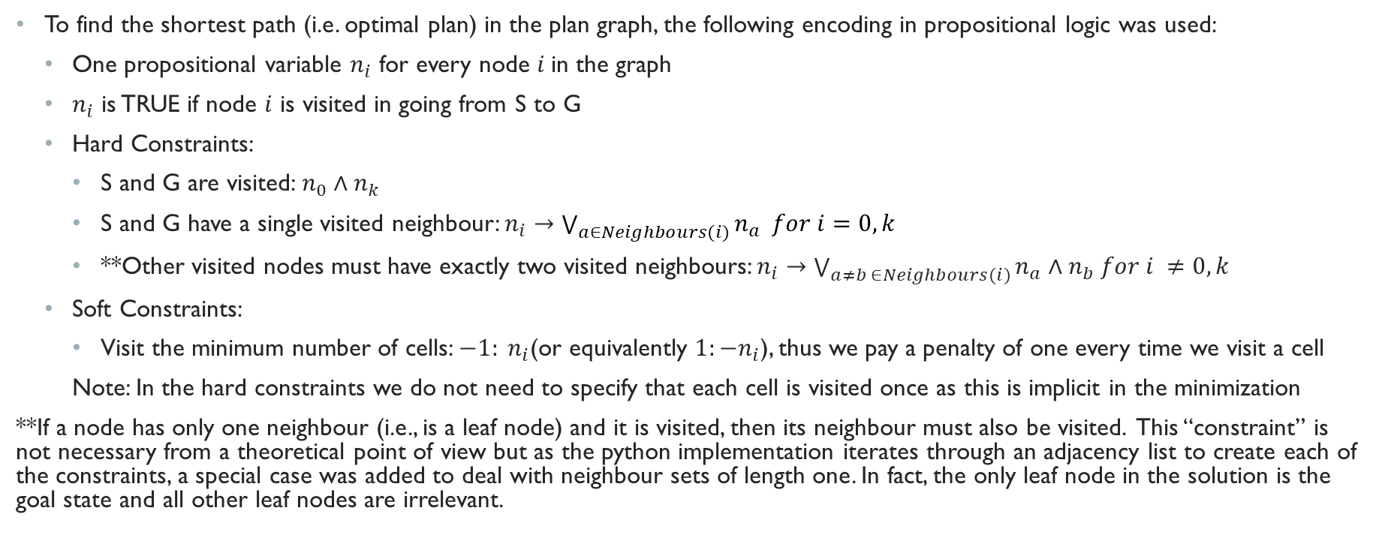
Shortest Path
To find the shortest path (i.e. optimal plan) in the plan graph, the following encoding in propositional logic was used:
One propositional variable $n_{i}$ for every node $i$in the graph
$n_{i}$ is TRUE if node $i$ is visited in going from S to G
Hard Constraints:
S and G are visited: $n_{0}∧n_{k}$
S and G have a single visited neighbour: $n_{i}→\bigvee_{a∈Neighbours(i)}{n_{a} for i=0, k}$
**Other visited nodes must have exactly two visited neighbours: $n_{i}→\bigvee_{a≠b ∈Neighbours(i)}{n_{a}∧n_{b} for i ≠0,k}$
Soft Constraints:
Visit the minimum number of cells: $−1: n_{i}$(or equivalently $1:−n_{i}$), thus we pay a penalty of one every time we visit a cell
Note: In the hard constraints we do not need to specify that each cell is visited once as this is implicit in the minimization
**If a node has only one neighbour (i.e., is a leaf node) and it is visited, then its neighbour must also be visited. This “constraint” is not necessary from a theoretical point of view but as the python implementation iterates through an adjacency list to create each of the constraints, a special case was added to deal with neighbour sets of length one. In fact, the only leaf node in the solution is the goal state and all other leaf nodes are irrelevant.

Slide 11
Demonstration of Solving the Planning Problem

Slide 12
The Assigned PROBLEM
Suppose we wish to solve the problem to the right
The initial state, S₀ = {OnTable(A), OnTable(C), OnTable(D), On(B, A), Clear(B), Clear(C), Clear(D), Empty}
The goal state, G = {OnTable(A), OnTable(D), On(C, A), On(B, D), Clear(B), Clear(C), Empty}
The plan graph is shown on the following slide. Each node (or state) represents a propositional variable in the planning domain.

Slide 13
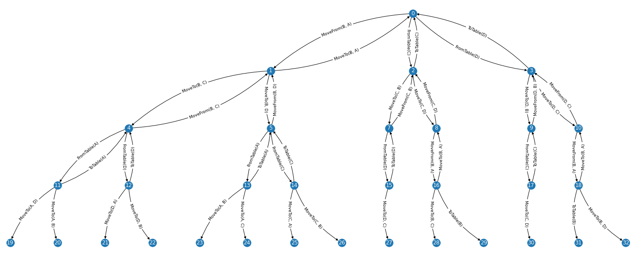
The PlanGraph

Slide 14
The Plan Graph
The plan graph for this problem is shown on the previous slide.
At each state, we parse the grounded predicates of the planning domain to see which preconditions are satisfied. This determines which actions are applicable at that state. Once the applicable actions are identified, we obtain new states by adding the add effects and removing the delete effects of the state. To prevent the program from entering an infinite loop, we track which states have been seen before and do not re-generate actions for states which have already been seen.
For readability of the plan graph, the full description of the states have been replaced by integers.
The mapping of states to integers is shown on the subsequent slides for reference

Slide 15
Node |  | Full State Description
0 |  | {'Clear(D)', 'Empty', 'OnTable(A)', 'Clear(B)', 'OnTable(C)', 'Clear(C)', 'OnTable(D)', 'On(B, A)'}
1 |  | {'Clear(D)', 'OnTable(A)', 'Clear(C)', 'OnTable(C)', 'Clear(A)', 'OnTable(D)', 'Hold(B)'}
2 |  | {'Hold(C)', 'Clear(D)', 'OnTable(A)', 'Clear(B)', 'OnTable(D)', 'On(B, A)'}
3 |  | {'Hold(D)', 'OnTable(A)', 'Clear(B)', 'OnTable(C)', 'Clear(C)', 'On(B, A)'}
4 |  | {'Clear(D)', 'Empty', 'On(B, C)', 'OnTable(A)', 'Clear(B)', 'OnTable(C)', 'Clear(A)', 'OnTable(D)'}
5 |  | {'Empty', 'OnTable(A)', 'Clear(B)', 'OnTable(C)', 'On(B, D)', 'Clear(C)', 'Clear(A)', 'OnTable(D)'}
6 |  | {'No solution1'}
7 |  | {'On(C, B)', 'Clear(D)', 'Empty', 'OnTable(A)', 'Clear(C)', 'OnTable(D)', 'On(B, A)'}
8 |  | {'Empty', 'OnTable(A)', 'Clear(B)', 'Clear(C)', 'On(C, D)', 'OnTable(D)', 'On(B, A)'}
9 |  | {'Clear(D)', 'Empty', 'OnTable(A)', 'Clear(C)', 'OnTable(C)', 'On(D, B)', 'On(B, A)'}
10 |  | {'Clear(D)', 'Empty', 'OnTable(A)', 'Clear(B)', 'OnTable(C)', 'On(D, C)', 'On(B, A)'}
11 |  | {'Clear(D)', 'On(B, C)', 'Clear(B)', 'OnTable(C)', 'OnTable(D)', 'Hold(A)'}
12 |  | {'Clear(D)', 'Empty', 'OnTable(A)', 'Clear(B)', 'OnTable(C)', 'Clear(C)', 'OnTable(D)', 'On(B, A)'}
13 |  | {'Clear(D)', 'OnTable(A)', 'Clear(C)', 'OnTable(C)', 'Clear(A)', 'OnTable(D)', 'Hold(B)'}
14 |  | {'Hold(C)', 'Clear(D)', 'OnTable(A)', 'Clear(B)', 'OnTable(D)', 'On(B, A)'}
15 |  | {'Hold(D)', 'OnTable(A)', 'Clear(B)', 'OnTable(C)', 'Clear(C)', 'On(B, A)'}
16 |  | {'OnTable(A)', 'Clear(C)', 'Clear(A)', 'On(C, D)', 'OnTable(D)', 'Hold(B)'}

Slide 16
17 |  | {'Hold(C)', 'Clear(D)', 'OnTable(A)', 'On(D, B)', 'On(B, A)'}
18 |  | {'Clear(D)', 'OnTable(A)', 'OnTable(C)', 'On(D, C)', 'Clear(A)', 'Hold(B)'}
19 |  | {'Empty', 'On(B, C)', 'Clear(B)', 'OnTable(C)', 'On(A, D)', 'Clear(A)', 'OnTable(D)'}
20 |  | {'Clear(D)', 'Empty', 'On(B, C)', 'OnTable(C)', 'Clear(A)', 'On(A, B)', 'OnTable(D)'}
21 |  | {'Clear(D)', 'Empty', 'On(B, C)', 'OnTable(A)', 'Clear(B)', 'OnTable(C)', 'On(D, A)'}
22 |  | {'Clear(D)', 'Empty', 'On(B, C)', 'OnTable(A)', 'OnTable(C)', 'On(D, B)', 'Clear(A)'}
23 |  | {'Empty', 'Clear(C)', 'OnTable(C)', 'On(B, D)', 'Clear(A)', 'On(A, B)', 'OnTable(D)'}
24 |  | {'Empty', 'Clear(B)', 'OnTable(C)', 'On(B, D)', 'Clear(A)', 'On(A, C)', 'OnTable(D)'}
25 |  | {'Empty', 'OnTable(A)', 'Clear(B)', 'On(B, D)', 'Clear(C)', 'On(C, A)', 'OnTable(D)'}
26 |  | {'On(C, B)', 'Empty', 'OnTable(A)', 'Clear(C)', 'On(B, D)', 'Clear(A)', 'OnTable(D)'}
27 |  | {'On(C, B)', 'Clear(D)', 'Empty', 'OnTable(A)', 'On(D, C)', 'On(B, A)'}
28 |  | {'Empty', 'On(B, C)', 'OnTable(A)', 'Clear(B)', 'Clear(A)', 'On(C, D)', 'OnTable(D)'}
29 |  | {'Empty', 'OnTable(B)', 'OnTable(A)', 'Clear(B)', 'Clear(C)', 'Clear(A)', 'On(C, D)', 'OnTable(D)'}
30 |  | {'Empty', 'OnTable(A)', 'Clear(C)', 'On(D, B)', 'On(C, D)', 'On(B, A)'}
31 |  | {'Clear(D)', 'OnTable(B)', 'Empty', 'OnTable(A)', 'Clear(B)', 'OnTable(C)', 'On(D, C)', 'Clear(A)'}
32 |  | {'Empty', 'OnTable(A)', 'Clear(B)', 'OnTable(C)', 'On(B, D)', 'On(D, C)', 'Clear(A)'}
Node 6 is “No Solution” because it arises from attempting to place Block B on the Table which only has space for 3 blocks, while Blocks A, C and D were already on the Table. “No solution” states are NOT plotted on the plangraph.

Slide 17
DIMACS ENCODING of Shortest Path
By assigning each state, i.e. the nodes of the graph to a unique integer, the DIMACS encoding of the problem can be obtained. Since 0 has a special meaning in DIMACS encoding i.e. an end of line or end of clause character, we simply increment all the node values by 1 to obtain a dimacs mapping of nodes to integers
The encoding for our problem has the header “p wcnf 33 106 34” then
Hard constraints:
Both S and G must be traversed
34 1 0
34 26 0
Both S and G must have single neighbour
34 -1 2 3 4 0
34 -26 15 0
All other nodes have exactly 2 neighbours (for example node 2):
34 1 5 -2 0
34 1 6 -2 0
34 5 6 -2 0
34 1 5 6 -2 0
Soft constraints:
1 -1 0
1 -2 0
1 -3 0
1 -4 0
Since RC2 SATSolver take input in Conjunctive Normal Form (CNF) form each constraint was first converted.

Slide 18
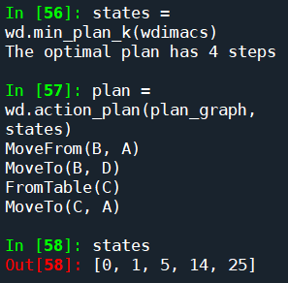
Optimal Plan
As a last step, we use the RC2 solver on the WCNF problem to obtain the shortest path.
The plan is composed of the actions (edges) which join the states (nodes) that are positive in the output model of the solver. These states each carry a cost of 1 as per the soft constraints.
The cost of the plan is therefore the total number of states chosen by the solver minus 1 (i.e. the number of edges)

Slide 19
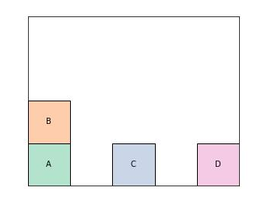
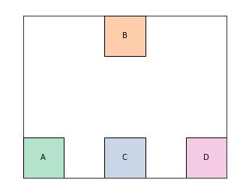
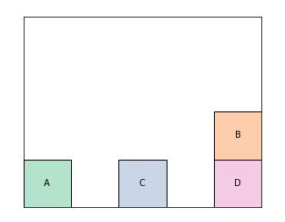
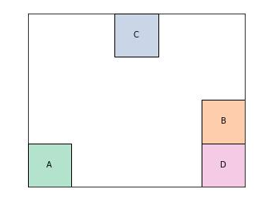
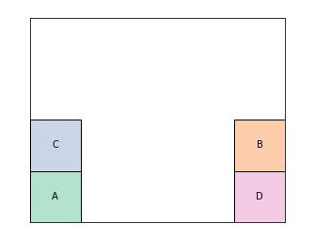
MoveFrom(B,A)
MoveTo(B,D)
State 0
State 1
State 5
FromTable(C)
MoveTo(C,A)
State 14
State 25

Slide 20
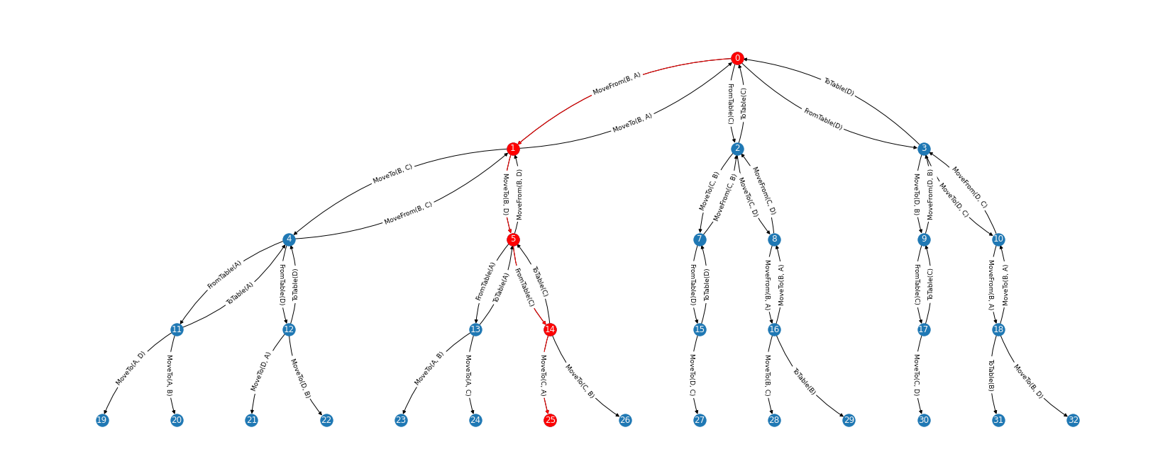
The Optimal plan Visualized on the Plan Graph

Slide 21
THANK YOU!

Slide 22
References
Robinson N et al. “A Compact and Efficient SAT Encoding for Planning” in Proceedings of the Eighteenth International Conference on Automated Planning and Scheduling. Sydney, Australia 2008
Martins R and Lynce I. “Effective CNF Encodings for the Towers of Hanoi” in International Conferences on Logic for Programming, Artificial Intelligence and Reasoning. Doha, Qatar 2008
Kautz H and Selman B. “Planning as Satisfiability” Proceedings of the 10th European Conference on Artificial Intelligence. Vienna, Austria1992

